Slide 1
Unit 6 SG 4
Introduction to Islam

Slide 2
A.Pre-Islamic Arabia
1. Bedouin: People of the Desert - communal life essential for desert living; people belonged to tribes (patriarchal); nomadic & sedentary; paganism - gods & goddesses associated with nature (water, stones, trees)

Slide 3
B. The Life of Mohammad
1. Born in 570 C.E. in Arabian city of Mecca; orphaned at young age and taken in by uncle Abu Talib
2. Worked as a merchant & a shepherd; first married at age of 25 to Khadijah a wealthy woman of 40; habitually would retreat to caves for seclusion & prayer
3. At age of 40 he claimed to have been visited by the angel Gabriel; 3 years later began preaching this event but had few followers; was met with hostility for preaching about one god
4. In 622, he fled Mecca for Medina, this event is known as the Hijra and marks the beginning of the Islamic calendar

Slide 4
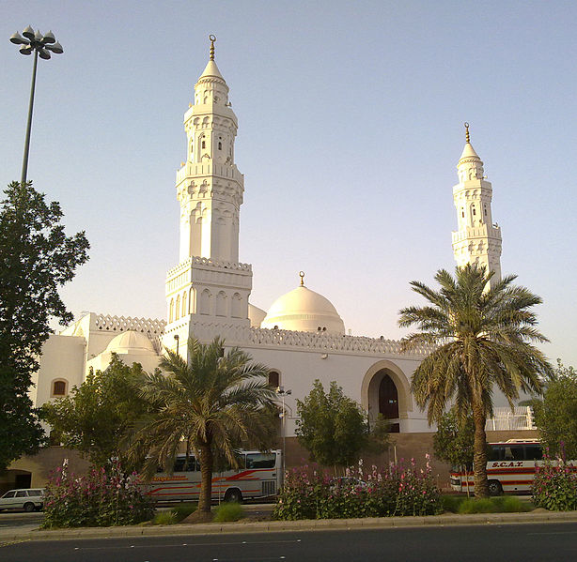
Mosque of the Two Qibias, Medina

Slide 5
B. The Life of Mohammad
5. In Medina he united the tribes and spent about 8 years fighting the tribes of Mecca. By this time he had about 10,000 followers
6. He finally took control of Mecca and all pagan idols in the city were destroyed (iconoclasm); sent followers out to destroy idols all over Arabia
7. Tradition holds that in 620 he experiences the Isra & Mi’raj - the miraculous journey to Jerusalem; site of Dome of the Rock
8. Died in 632, most of Arabia was already converted to Islam at this point

Slide 6
C. Islam’s Sacred Texts & Literature
1. Hadiths (tradition) - written as hearsay not considered a primary source; form the basis of Islamic law, despite some contradictions with the Quran; different denominations rely on different hadiths

Slide 7
C. Islam’s Sacred Texts & Literature
2. Quran (the Recitation) - central religious text of Islam; believed to be revelation from Allah to Mohammad over a period of 23 years; believed to be the only book protected by Abrahamic God from distortion or corruption; writings collected after Mohammed’s death; proof of prophethood
a. Key themes - responsibility to Allah; resurrection of the dead; God’s final judgement; descriptions of the tortures of Hell & pleasures of Heaven
b. Religious duties - belief in Allah; asking for forgiveness of sins; assisting those in need; rejecting love of wealth; being chaste; not killing newborn girls (tribal tradition)

Slide 8
D. The Basic Doctrines of Islam
1. Monotheism: Islam - He is God, the One and Only; God, the Eternal, Absolute; He begetteth not, nor is He begotten; And there is none like unto Him."
(a) Muslims & Jews reject the Holy Trinity & the divinity of Jesus, comparing it to polytheism
(b) Purpose of existence is to worship Allah
(c) Viewed as personal, a god who will respond to prayer

Slide 9
D. The Basic Doctrines of Islam
2. Angels
(a) Do not possess free will & worship Allah in total obedience
(b) Duties: communictions from Allah, glorifying Allah, recording death’s, taking soul at death
(c) Made of light

Slide 10
D. The Basic Doctrines of Islam
3. Prophets (human messengers)
(a) Human not divine, but can perform miracles.
(b) In Islam - Adam, Noah, Abraham, Moses, Jesus, & last, Mohammed...among others
(c) The Hadiths recount Mohammad’s life, his words, his actions, & personal characteristics (Sunnah - the trodden path) - emulate him life

Slide 11
D. The Basic Doctrines of Islam
4. A last day: resurrection & judgement
a. Quran emphasizes bodily resurrection
b. All mankind will be judged on their good & bad deeds

Slide 12
D. The Basic Doctrines of Islam
5. Absolute predestination - everything in the world that occurs, good or bad, has been preordained and nothing can happen unless permitted by God. According to Muslim theologians, although events are pre-ordained, man possesses free will in that he or she has the faculty to choose between right and wrong, and is thus responsible for his actions.

Slide 13
E. The Basic Duties of Islam: The Five Pillars of the Faith
1. Shahadah: Recite the creed - "I testify that there are no deities other than Allah alone and I testify that Muhammad is his Messenger."
(a) Must be recited in prayer
2. Salat: Prayer
(a) Must be performed 5 times, daily, in Arabic
(b) Prayer must consist of verses from the Quran

Slide 14
E. The Basic Duties of Islam: The Five Pillars of the Faith
3. Zakat: Almsgiving - giving a fixed portion of accumulated wealth to the poor & the needy
4. Fast of Ramadan - no food or drink from dawn to dusk during the month of Ramadan (not obligatory if perceived as undue burden (i.e. illness)

Slide 15
E. The Basic Duties of Islam: The Five Pillars of the Faith
5. Hajj - Pilgrimage to Mecca
(a) Must be completed at least once in lifetime during Islamic month of Dhu al-Hijjah (financially & physically able)
(b) Spending time in desert, walking in the footsteps of Abraham, symbolically stoning the Devil
(c) Walking 7 times around the Kaaba, Mount Safa & Mount Marwah (footsteps of Hagar)

Slide 16
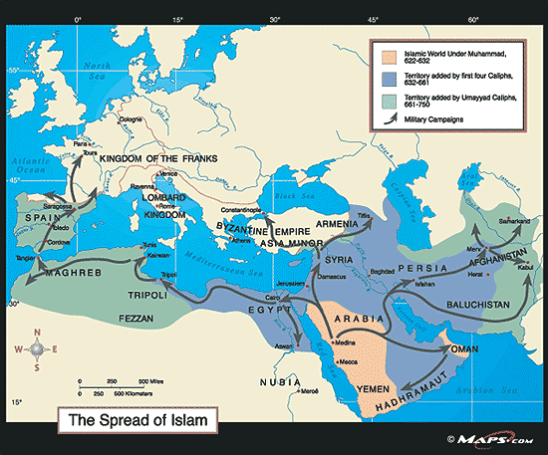
F. Historical Development of Islam

Slide 17
F. Historical Development of Islam
1. Caliphates
a. Early Caliphs & Umayyads: 610-750 CE
b. Abbasids: 750-1258
c. Seljuks: 950-1450
d. Ottoman Empire - 1299-1924

Slide 18
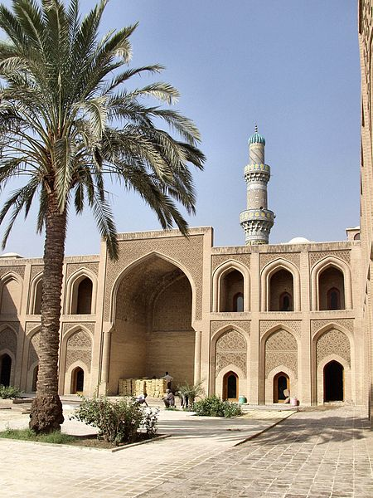
Mustansiriya University in Baghdad
Abbasids established Houses of Wisdom

Slide 19
G. Islamic Art & Architecture
1. Depiction of human form considered idolatry
2. Focuses on calligraphy and patterns

Slide 20
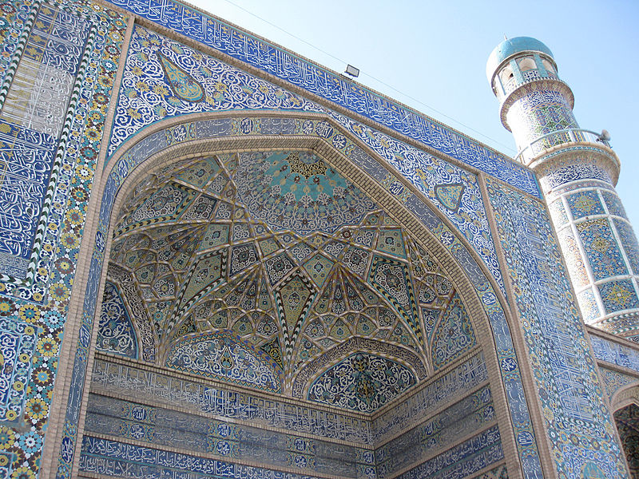

Slide 21
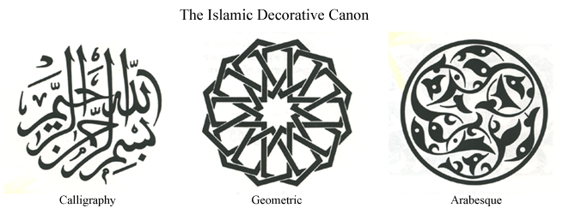
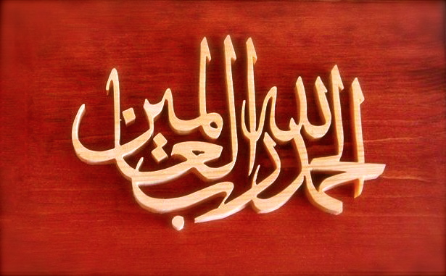
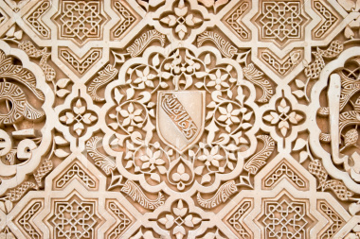

Slide 22
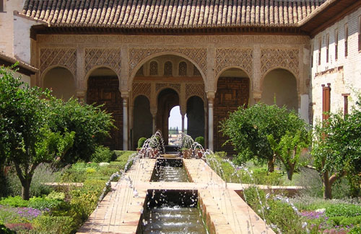
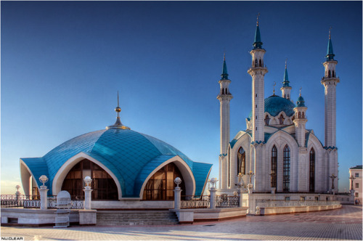
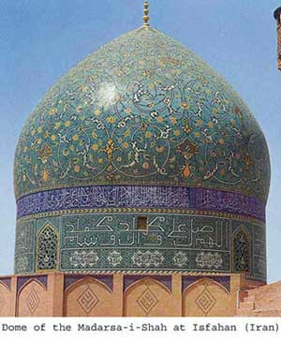
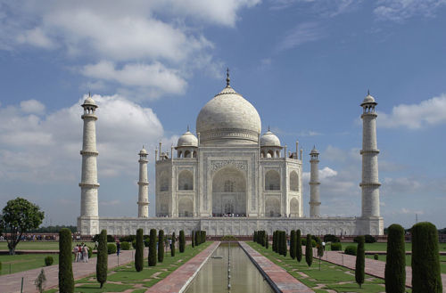

Slide 23
H. Islamic Organization & Structure
1. The Shari’ah is Islamic law formed by traditional Islamic scholarship
a. System of duties that are incumbent upon a Muslim by virtue of their religious belief
b. Covers all aspects of life, from matters of state & foreign relations, to daily life
2. Etiquette & Diet - only right hand used for eating & drinking; circumcision; not allowed to eat pork or drink alcohol; permissible food is halal (in Judaism - kosher)

Slide 24
H. Islamic Organization & Structure
3. Family - is the basic unit of Islamic society
a. Father seen as financially responsible & obliged to cater to well-being
b. Marriage is a civil contract; bridal price typical; polygamy allowed but limited
c. Quran verses include: each gender has specific divorce rights; Mohammad praised education of women in Medina; Khadijah was employed outside of home
d. Many pre-Islamic tribal traditions still part of culture including: honor killings (not in Quran; needing 4 male witnesses to prove rape)

Slide 25
H. Islamic Organization & Structure
4. Jihad: “to strive or struggle - military exertion against non-believer/non-Muslim combatants who have insulted Islam

